Slide 1

Welcome!
We will be starting very soon!

Slide 2
Agenda:
Overview of BLE and Capabilities
Developing Accessories
Connectivity though the Pet Tutor App
- Submitting to the Pet Tutor mini-app store
iOS App Development for Pet Tutor

Slide 3
Overview:
BLE and its Capabilities:
Very low power connectivity
Wireless connectivity to device from Mac, PC, Phone, Tablets (even wireless programming)
Wireless range between 50-120ft
Constantly Evolving Eco System
Direct connection to the internet via built in IP stacks in upcoming version
http://www.bluetooth.com/Pages/Bluetooth-Smart.aspx

Slide 4
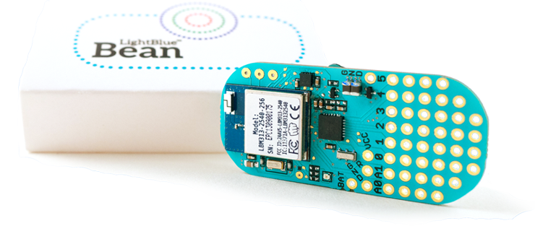
Overview (cont.):
The Punch Through Design Bean:
3-axis accelerometer
Temperature sensor
RBG LED
CR2032 Battery Powered
Atmega 328p 8mhz, 3V
6 digital I/O pins, 2 analog
Bluetooth LE Peripheral (wireless programming)
Supports OSX, iOS, and Win 8
Android coming soon!
https://punchthrough.com/bean/
Our commitment to BLE

Slide 5
Developing Accessories
Pet Tutor Mobile App
Your Accessory
Pet Tutor Feeder

Slide 6
Developing Accessories
Arduino Code to Trigger a Feeder:
Serial.write("CMD-ACCESSORY-FEED");
OR
Bean.setScratchNumber(5, 1);

Slide 7
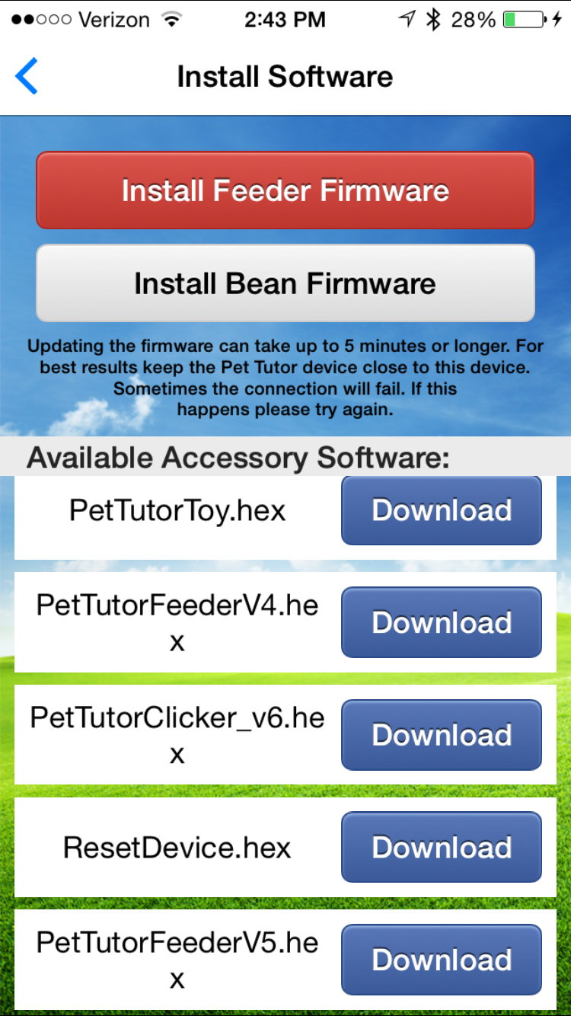
Connectivity though the Pet Tutor App

Slide 8
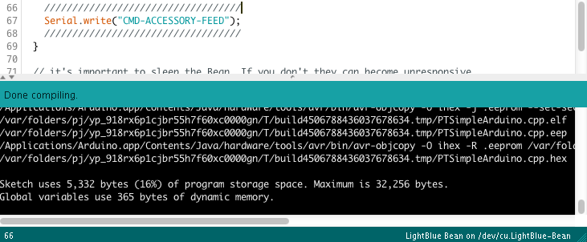
Submitting to Mini-app Store
To get this level of feedback you must go to Arduino’s preferences and select:

Slide 9
iOS App Development for Pet Tutor
iOS Code to Trigger a Feeder:
[bean sendSerialString:@"CMD-FEED"];
OR
int feedValue = 1;
[selectedBean setScratchBank:5 data:
[NSData dataWithBytes:&feedValue length:sizeof(feedValue)]];

Slide 10
GitHub Introduction
Demos Available At:
https://github.com/PetTutor/PetTutor-SDK-Demos
Git Hub Help:
https://git-scm.com/book/en/v2/Getting-Started-Git-Basics
https://www.youtube.com/watch?v=0fKg7e37bQE

Slide 11
Questions?

